Slide 1

Object detection ANDAUTONOMOUS Drone Simulation Using ROS and Ardupilot
TEAM – 33
AADARSH AADITYA A (CB.EN.U4AIE20001)
B.E. PRANAV KUMAAR (CB.EN.U4AIE20052)

Slide 2
Introduction
A drone, in a technological context, is an unmanned aircraft. Drones are more formally known as unmanned aerial vehicles (UAVs) or unmanned aircraft systems (UASes). Essentially, a drone is a flying robot. There are different types of drones based on distance/capability and flight mechanism type,
Single Rotar
Multi Rotar
Fixed wing
We are going to be simulating quadcopters which falls under the Multi-Rotor Drone Category.
Drones have applications in Warfare, Agriculture, Firefighting, Payload Delivery, Science...

Slide 3
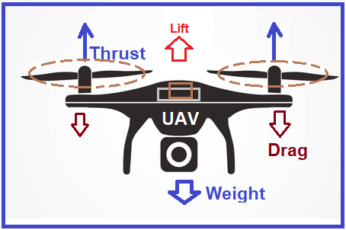
QUADCOPTER FLIGHT DYNAMICS
Theory:
Thrust – The force acting on an object perpendicular to the surface.
Lift – The force that directly opposes the weight of the aircraft.
Drag – The force acting opposite to the relative motion of any object moving.
Dimension of Newton - M¹ L¹ T⁻²
Torque – The twisting force that tends to cause rotation.
τ = rFsin⁡𝜃
Dimension of Newton meter - M L²T⁻²
Here,
r is the radius
F is the force
θ is the angle between F and lever arm

Slide 4
Torque Balancing
Most Multi-Rotor drones use even number of propellers, this is an easy way to balance the net Torque created by the propellers.
In accordance to Newtons 3rd Law the propeller rotation generates a torque opposite of its own onto the body of the drone, if this torque is not dealt with it will lead to instability.
An easy way to deal with this torque is to use an additional propeller that rotates in the opposite direction equivalent to the first one, similarly this imbues an equivalent torque in the drone that cancels the prior propeller’s caused torque.
Hence, the pair of propeller’s torque balance out and the net torque on the drones body is zero.

Slide 5
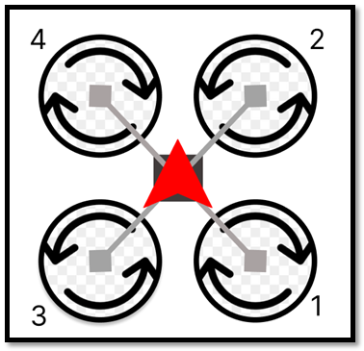
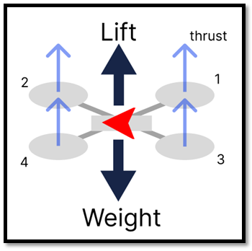
Drone Convention
Top View
It is important to note that the propellers are designed to push air in the same direction (downwards) regardless of the direction of rotation of the propeller.
For our equations we are going to neglect drag.
Side View

Slide 6
The individual thrusts generated by our drones will be obtained using,
Ti = ρ A v²_{i}
The collective Lift force is given by,,
L = Tnet=ρA∑⁴_{i=1}v²_{i}
The Weight is given by,
W = mg
Here,
‘i’ refers to the ith propeller
A is the cross-sectional area of the propeller
ρ is the density of air
v is the velocity

Slide 7
Fight Maneuvers
Hovering
Ascent and Descent
Forward and Backward Motion
Left and Right Motion
Left (Anticlockwise) and Right (Clockwise) Rotation

Slide 8
1. Hovering
The following motions 1 and 2 require only a change in position but not in orientation. Hence the propellers are expected to run at the same velocity.
Hovering is the configuration of the drone in which it remains at the same point without any change in position or orientation. When the weight and the Lift are equal the drones vertical position remains the same.
upward force = downward force
L = W
2. Ascent and Descent
During Ascent the drone's altitude/height with respect to ground in consideration is expected to increase, this can be achieved when,
upward force > downward force
L > W
During Descent the drone's altitude/height with respect to ground in consideration is expected to decrease, this can be achieved when,
upward force < downward force
L < W

Slide 9
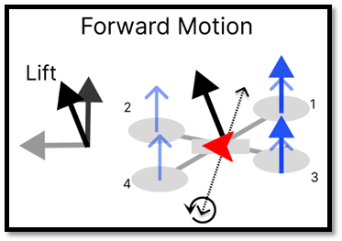
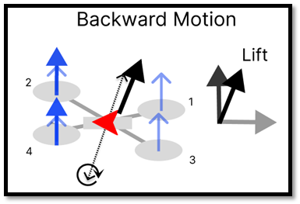
3. Forward and Backward Motion
The forward and backward motions are impossible to achieve in the quadcopters because there are not actuators that control force about the axis. To creatively overcome this issue drones, manipulate their pitch in order to direct a portion/component of their Lift to act in the forward or backward direction.
For our drone, Forward motion can be achieved by increasing the thrusts of the 1st and 3rd propellers and Backward motion can be achieved by increasing the thrusts of the 2nd and 4th propellers.

Slide 10
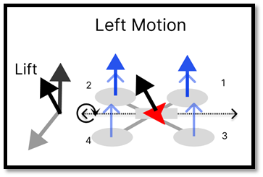
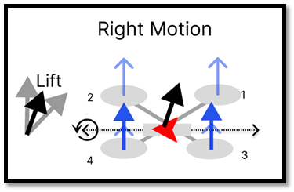
4. Left and Right Motion
Similar to Forward and Backward the Left and Right motions are possible via manipulation roll.
For our drone, left motion can be achieved by increasing the thrusts of the 1st and 2nd propellers and Right motion can be achieved by increasing the thrusts of the 3rd and 4th propellers.

Slide 11
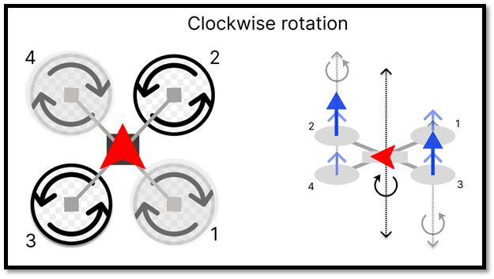
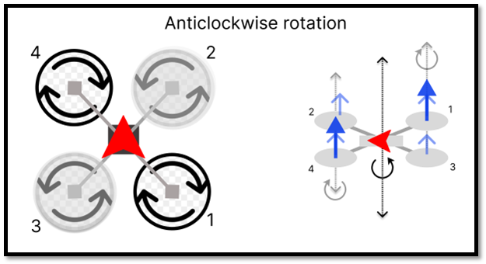
5. Left (Anticlockwise) and Right (Clockwise) Rotation
When the thrust/force generated by clockwise rotating propellers is increased the torque generated by them in turn is increased. Whereas the thrust generated by the anticlockwise rotating propellers remains the same. Naturally, there will be a net negative torque and equivalent positive torque in the drone's body. This torque allows the drone to rotate left.
The same can be inferred for clockwise rotation, allowing the drone to rotate right.
For our drone, Anticlockwise rotation can be achieved by increasing the thrusts of the 1st and 4th propellers and Clockwise rotation can be achieved by increasing the thrusts of the 2nd and 3rd propellers.

Slide 12
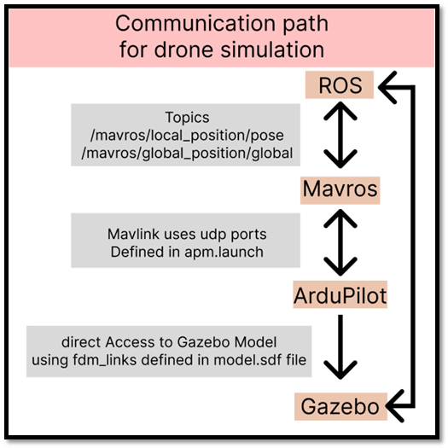
Implementing Fight Maneuvers onto the Gazebo Drone
Ardupilot uses MAVLink Protocol. Hence, we need two packages, MAVLink and MAVROS to facilitate communication between ROS and Ardupilot. MAVROS acts as a middleman to talk between ROS and Ardupilot. Once the packages for ROS (MAVLink and MAVROS) are installed, communication can be configured in the apm.launch file within MAVROS Package.

Slide 13
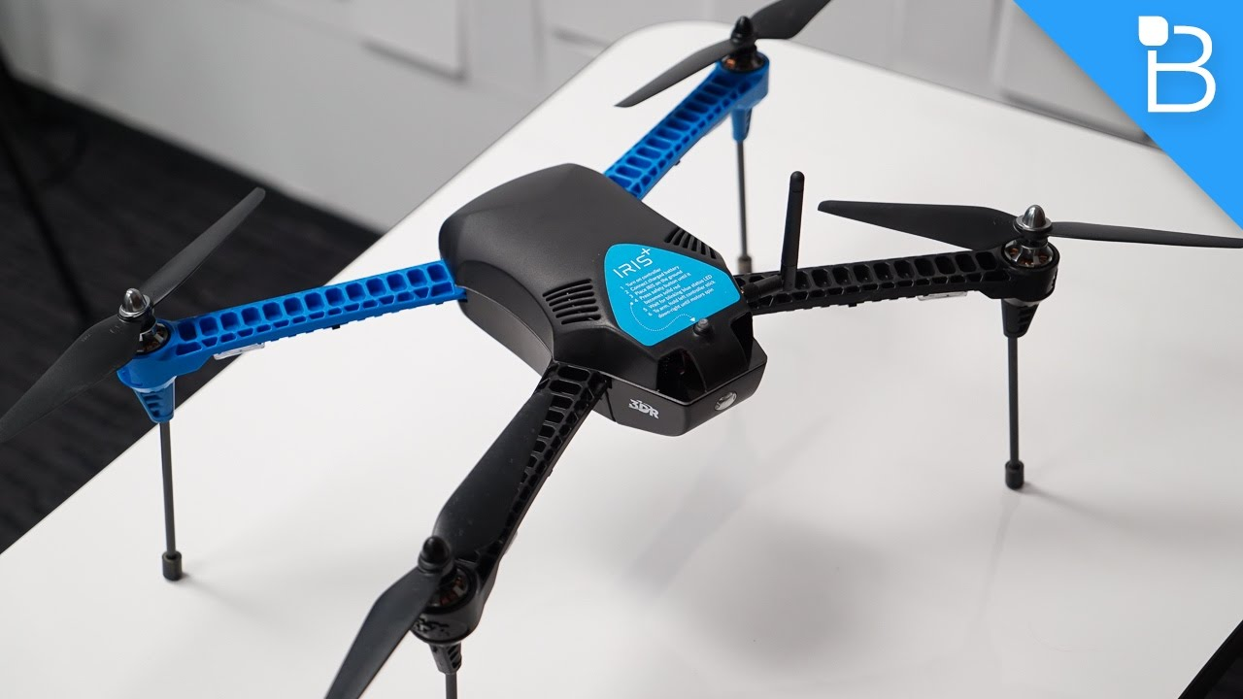
Drone Model
The drone model, is taken from https://github.com/PX4/sitl_gazebo/tree/master/models
It contains basic Model Definition of the IRIS Drone.
Camera Is added on top of the drone and a new model, inherited from the iris drone named "drone_with_camera" is defined

Slide 14
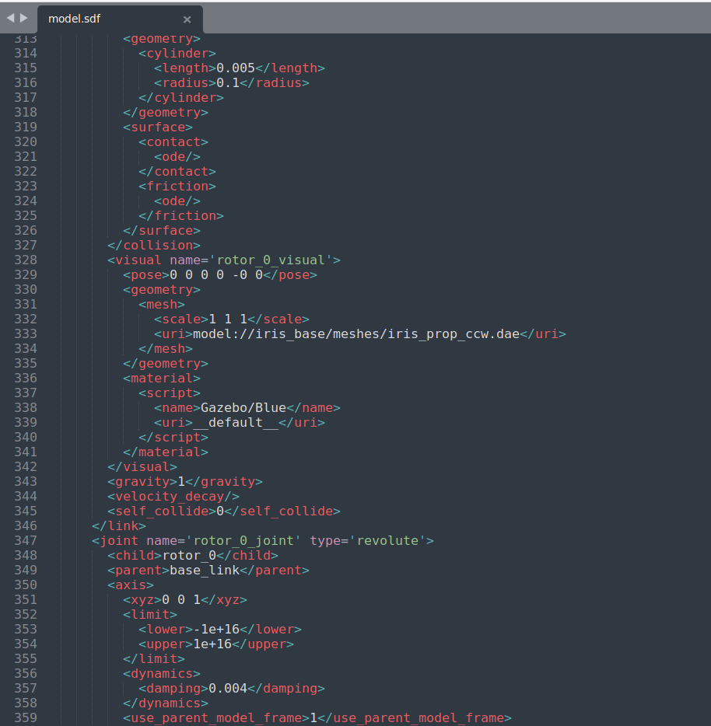
Model.sdf
Inheriting the existing Iris base mesh
{
Using the desired material
{
Defining basic physics
Defining Rotar joint using a revolute joint to enable it to work as intended
{
Defining rotating axis
{
Defining limits and damping

Slide 15
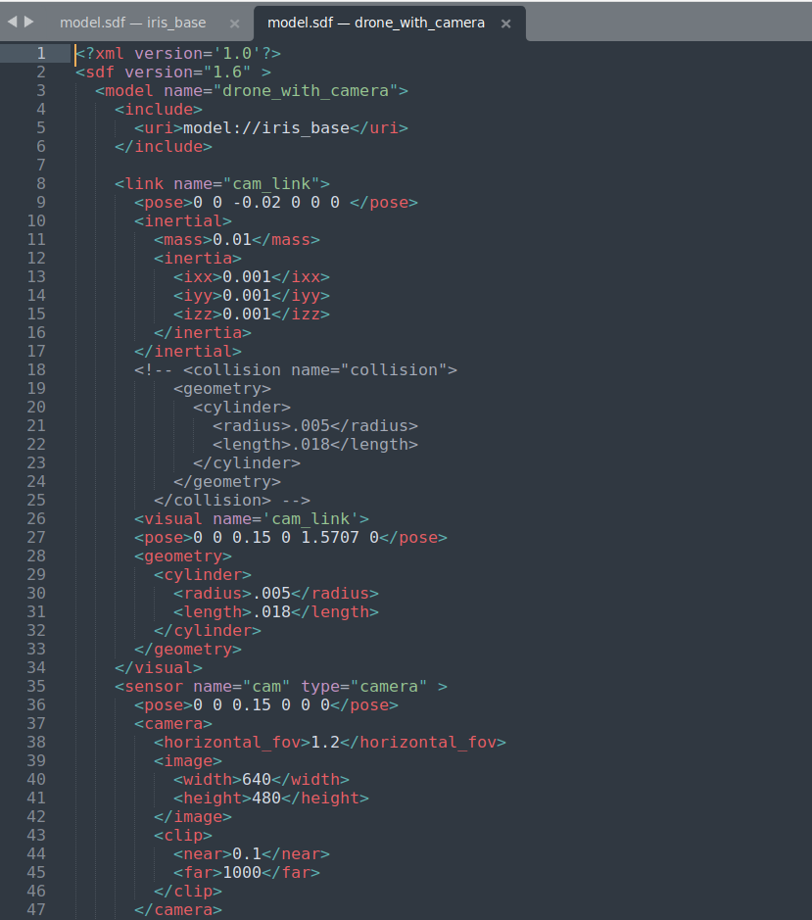
Drone with Camera
{
{
Inheriting the existing Iris_base model entirely to make modifications
{
Link defined with relatively small inertia
Removed collision for cam in order to not break during simulation
Defining the camera sensor
{

Slide 16
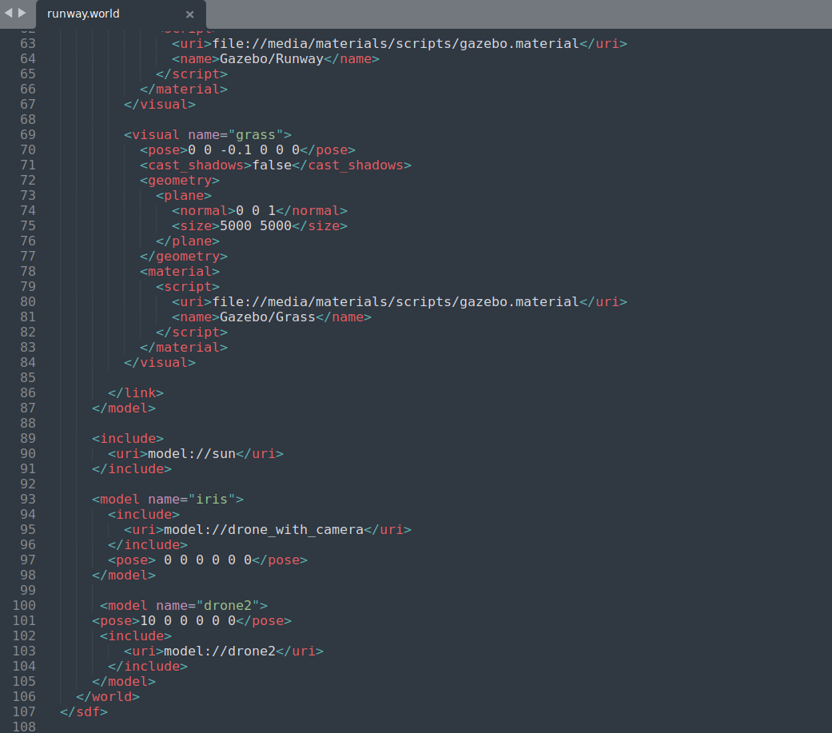
Worlds
Add a world, with runway and drone. Name it runway.world
Background aspect of the world
}
}
Instance of drone with camera
}
Instance of default drone

Slide 17
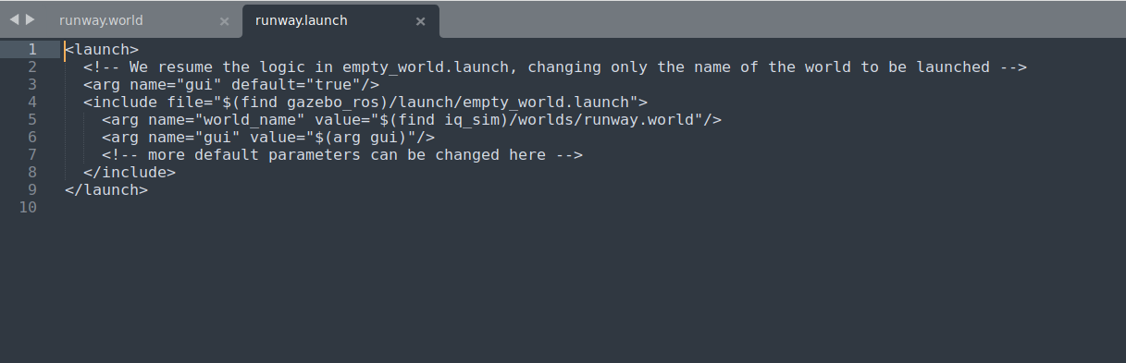
Launch File
/worlds/runway.launch"/>
Launch simulation by running
Roslaunch iq_sim runway.launch

Slide 18
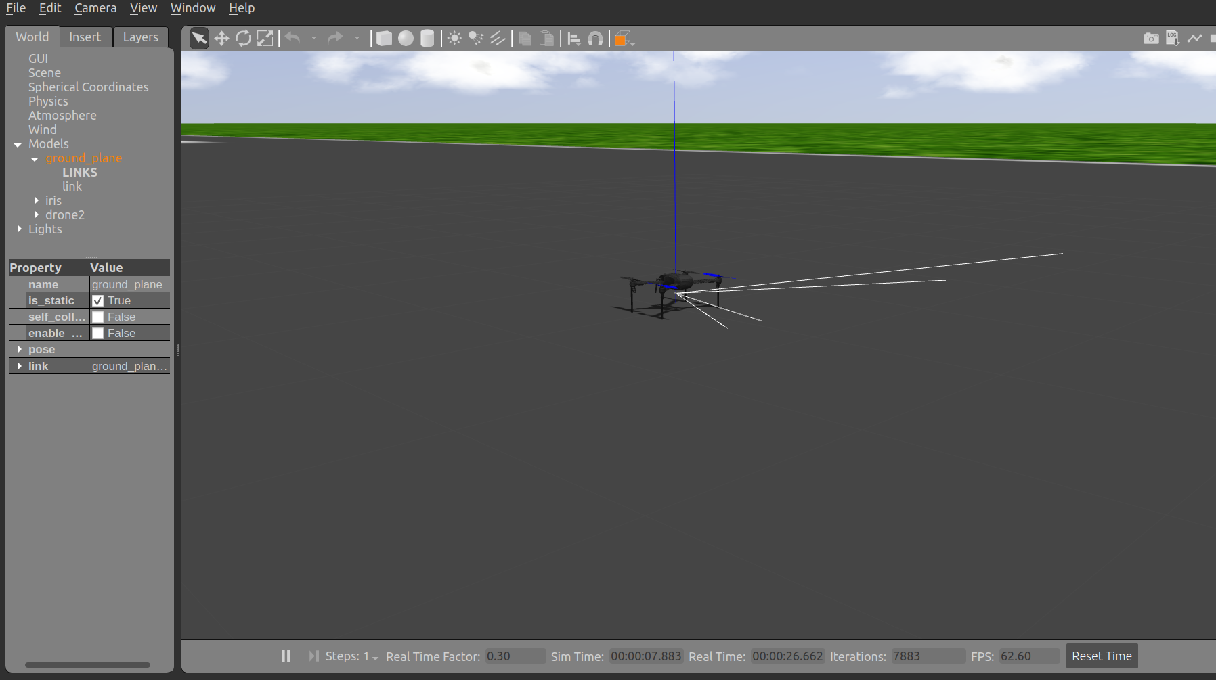

Slide 19
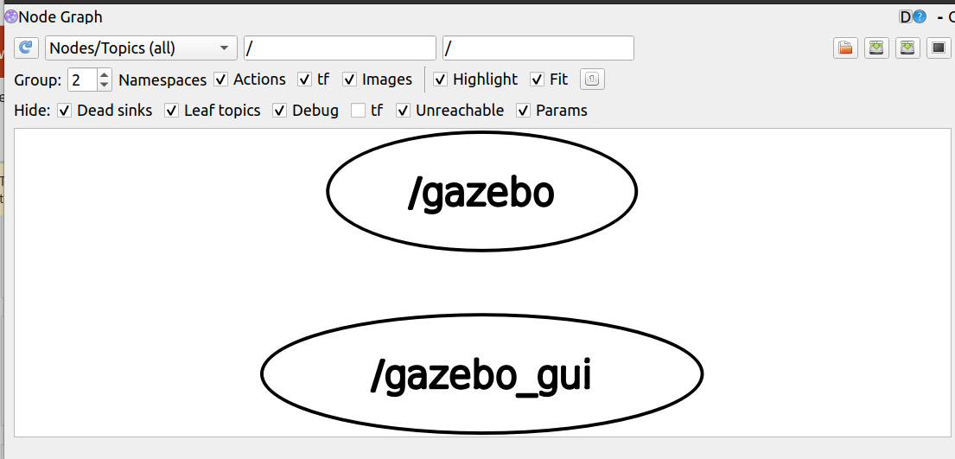

Slide 20
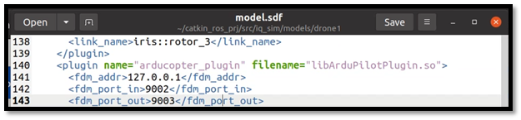
How Ardupilot controlls the drone?
The drone(Gazebo) and Ardupilot talks through UDP/TCP Sockets. This is ment to simulate serial communication/PWM signals in real life. For this reason, Arducopter_Plugin must be installed and configured from within the model definition.
The above snippet tells the drone to use port number 9002 and 9003 for communications

Slide 21
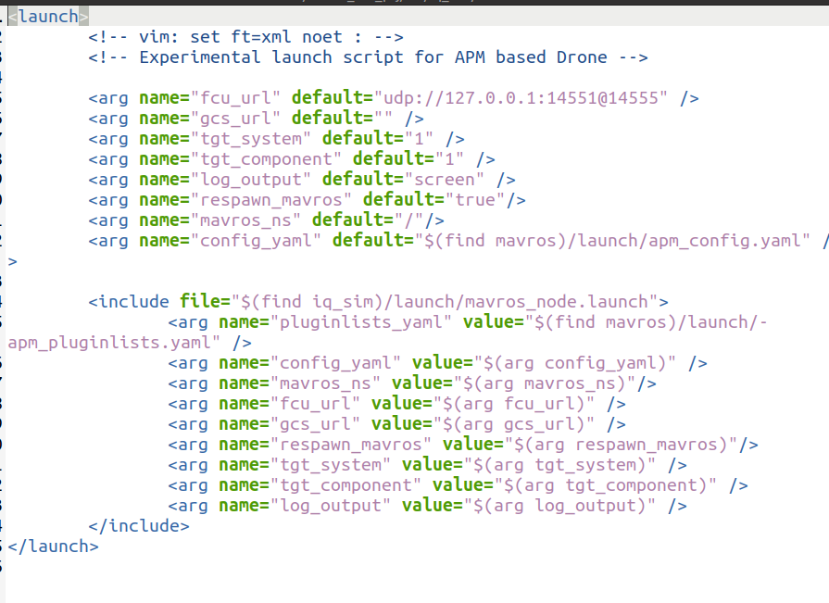
How Ardupilot controlls the drone?
The Flight Control Unit (FCU) Itself talks to ardupilot through UDP communication. Ardupilot has apm.py which is responsible for controlling based on the reading of IMU
UDP Port configuration
Ros_launch iq_sim apm.launch
Mavros launch node

Slide 22
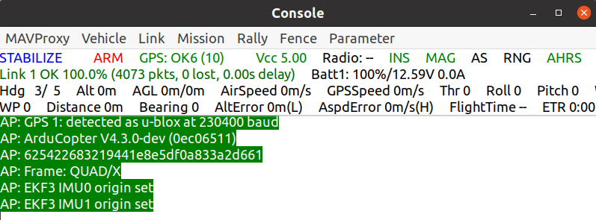
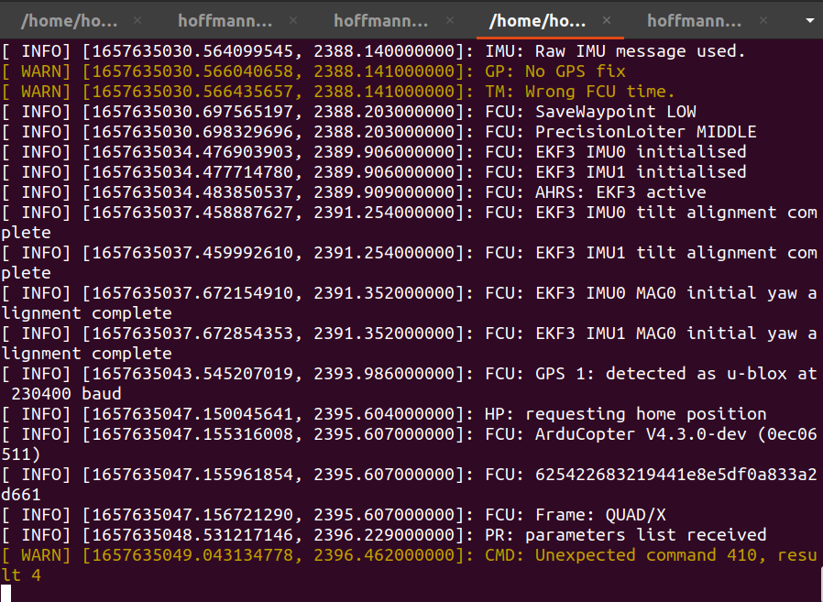
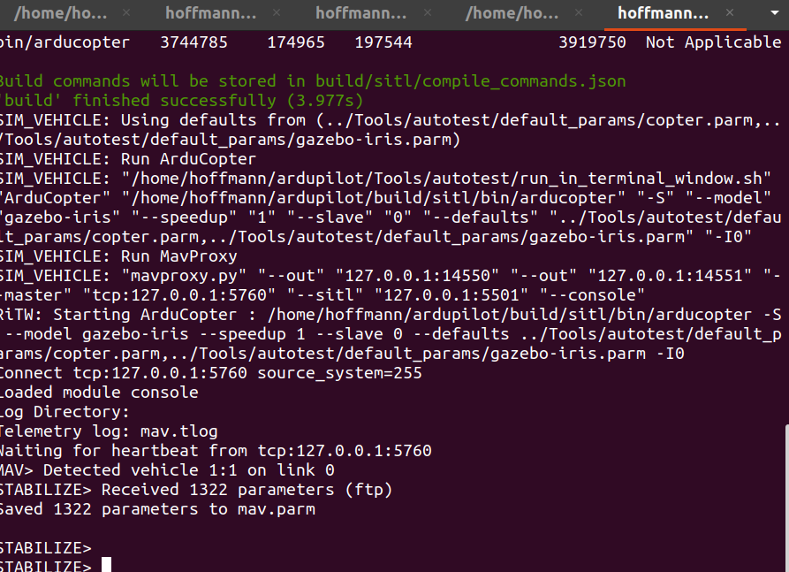
Start Ardupilot Controller
sim_vehicle.py -v ArduCopter -f gazebo-iris --console

Slide 23
Start Ardupilot Controller
sim_vehicle.py -v ArduCopter -f gazebo-iris --console
We can send controll signals from here.(MAVLink)

Slide 24
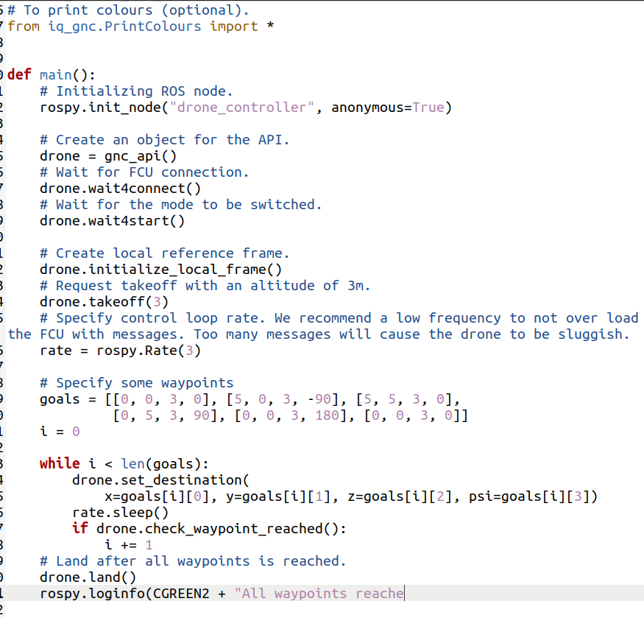
We can similarly control it from program
Iq_gnc library

Slide 25
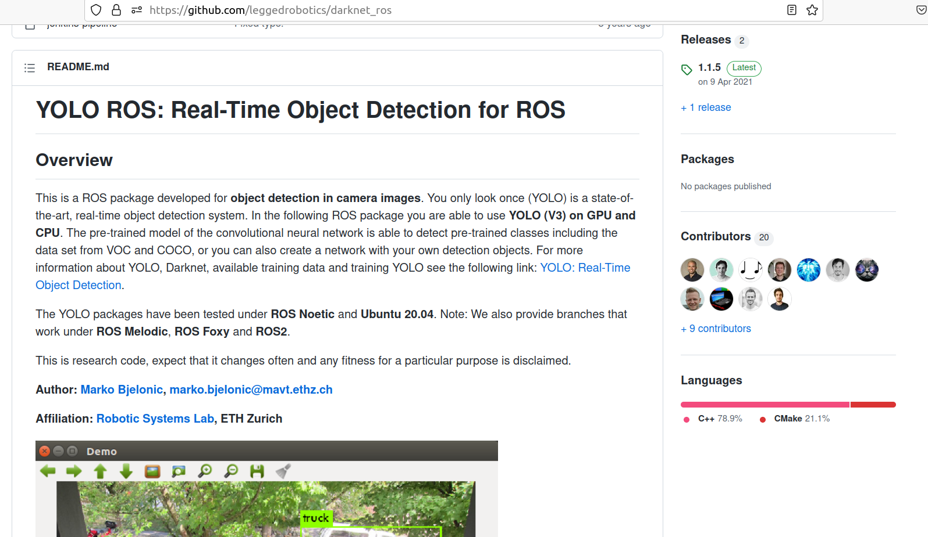
Object Detection Using YoLo
https://github.com/leggedrobotics/darknet_ros

Slide 26
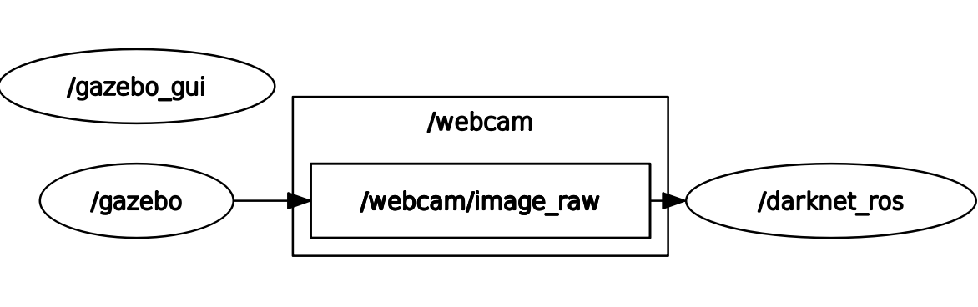
Object Detection Using YoLo
Roslaunch darknet_ros darknet_ros
Change subscription topic from config.yaml file

Slide 27
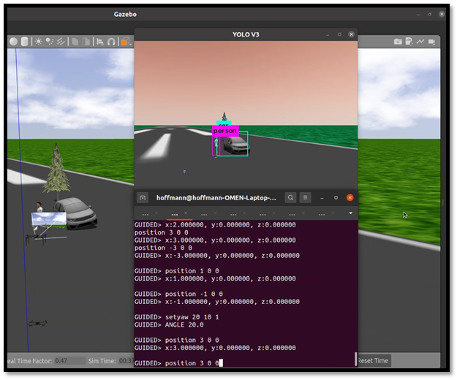
Object Detection Using YoLo

Slide 28
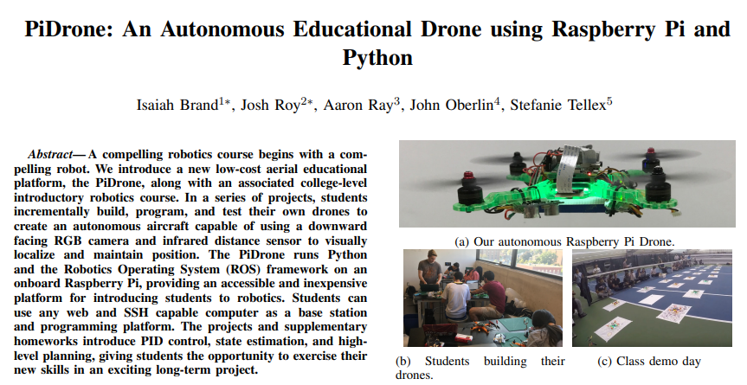
Future Scope

Slide 29
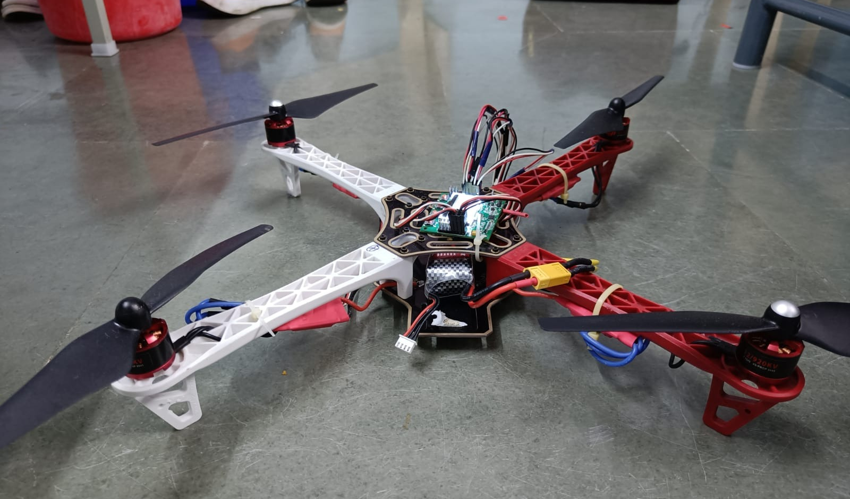
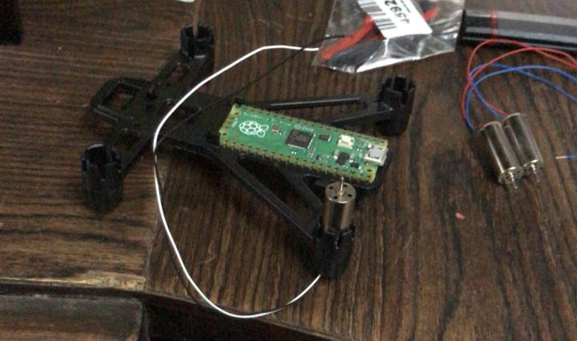
Unsuccessful attempts

Slide 30
Thank you

